Slide 1
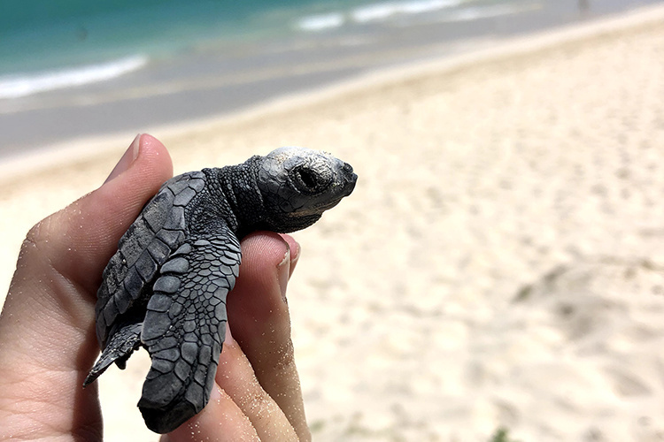
Population Growth

Slide 2
Learning Goals
Describe and apply techniques used by ecologists to survey populations

Slide 3
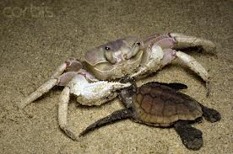
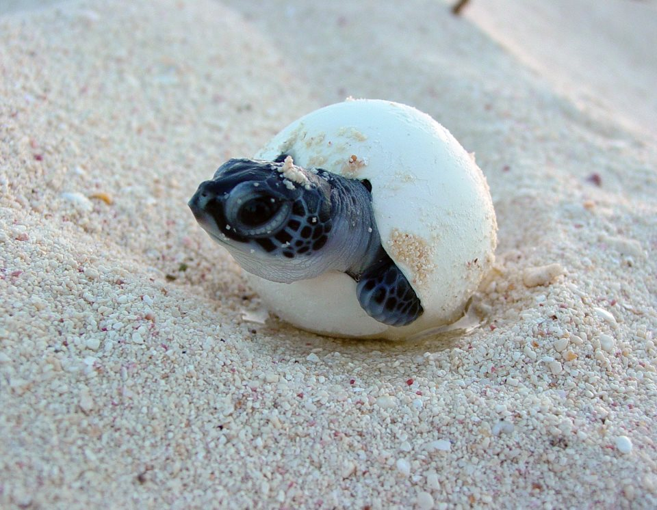
Population ecology:
sea turtles
Sea turtles lay eggs in a nest on sandy beaches
Eggs hatch and juveniles make their way to the sea, avoiding predators
Most die in their first year of life
About 20% die each year after that
Reach maturity in 20-30 years

Slide 4
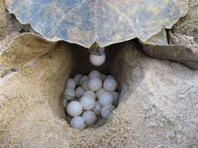
Population ecology
Focus on abiotic and biotic factors that:
Lead to population growth or decline
Affect spatial distribution of a population
Affect age structure of a population
Affect genetic structure of a population

Slide 5
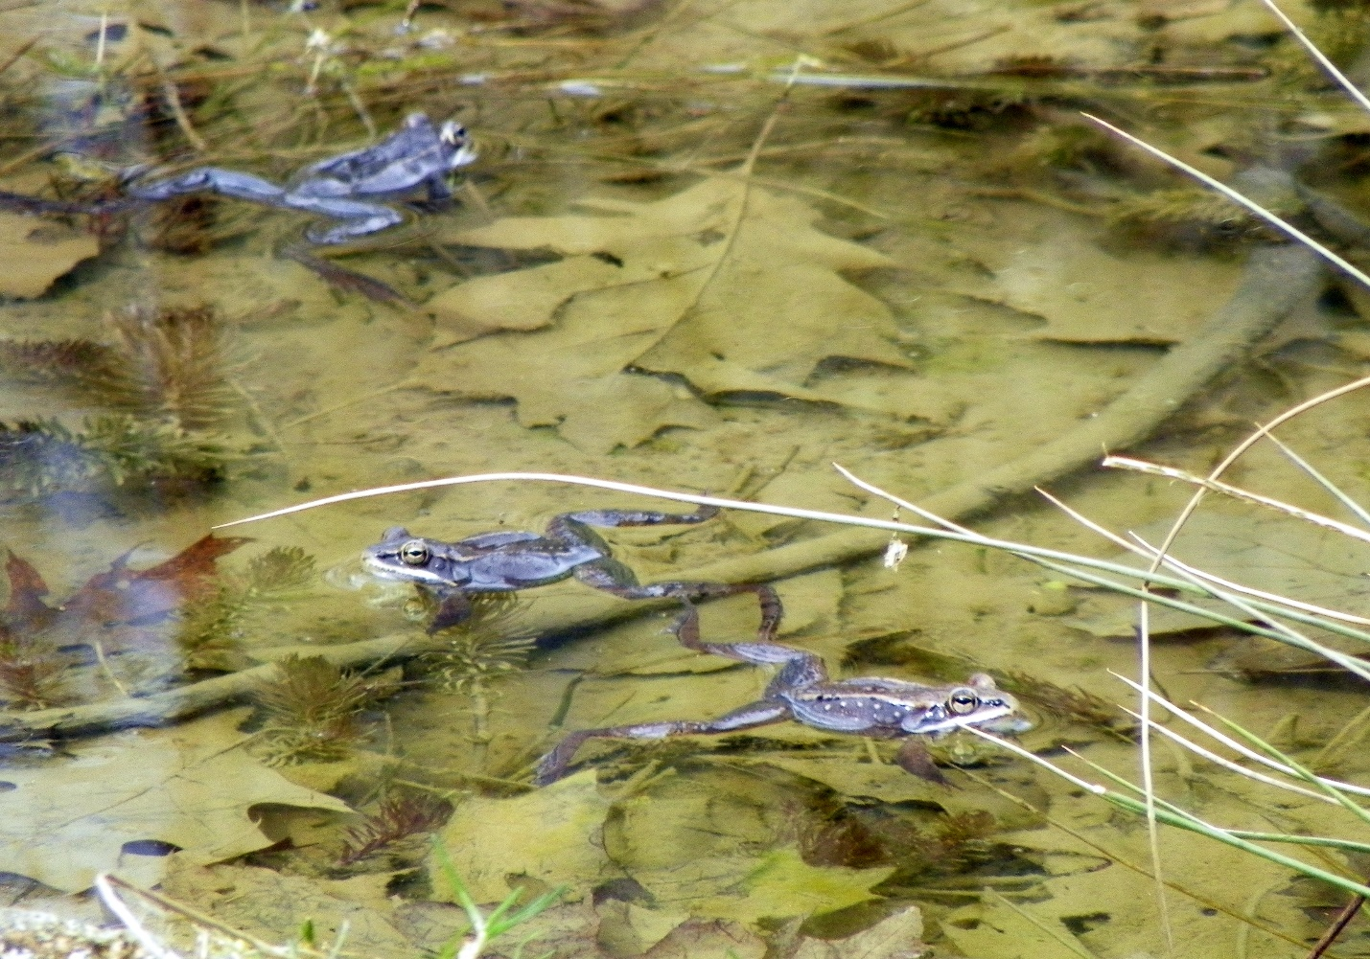
What is a population?
Group of individuals of a single species living in the same area
Rely on the same resources
Influenced by same environmental factors
Interact and interbreed with one another

Slide 6
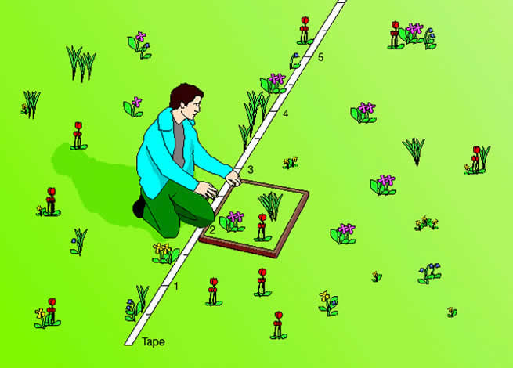
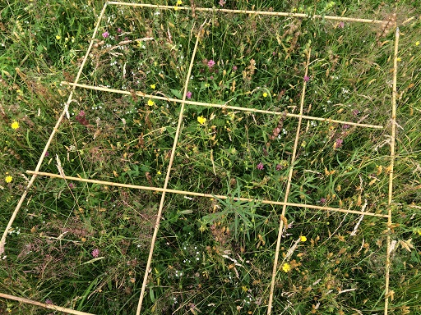
What is population density?
The number of individuals per unit area
Density estimates for sessile organisms like plants are derived from surveys of fixed area plots

Slide 7
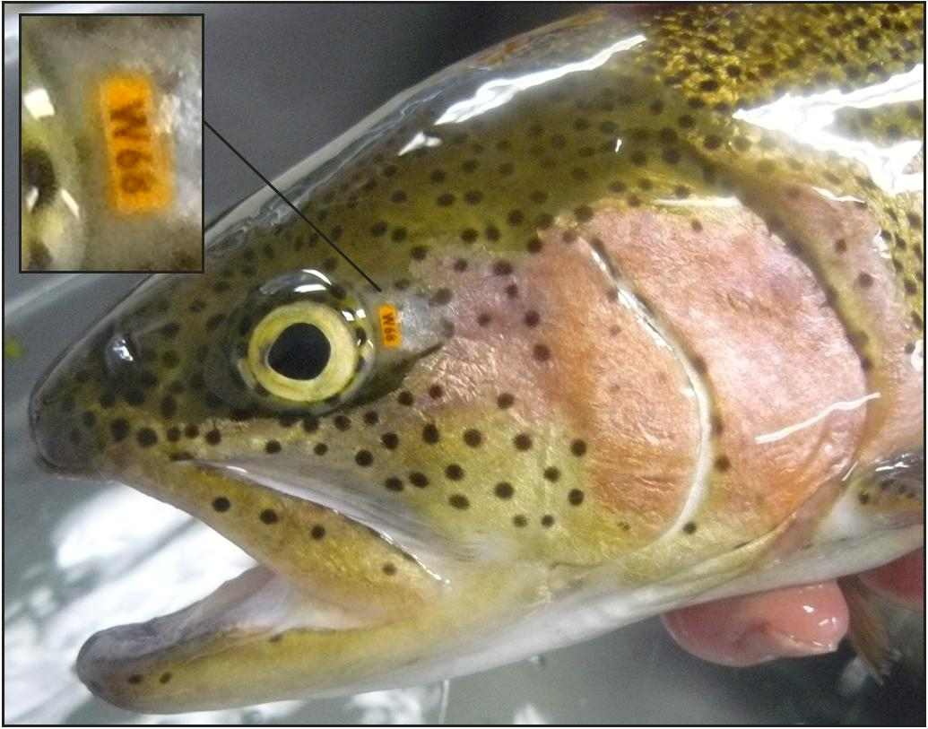
Surveying mobile or cryptic species
Mark-recapture survey
Two samples, three data values
The number of individuals caught and marked (s) at the first sampling
The number of individuals caught (n) at the second sampling
The number of individuals caught at the second sampling that were caught in the first sampling and marked, (x)

Slide 8
Mark-recapture formula
N = (s)(n)/(x)
N is the calculated number of individuals present
(s) = caught and marked at the first sampling
(n) = all caught in the second sampling
(x) = caught in the second sampling that had marks from the first sampling

Slide 9
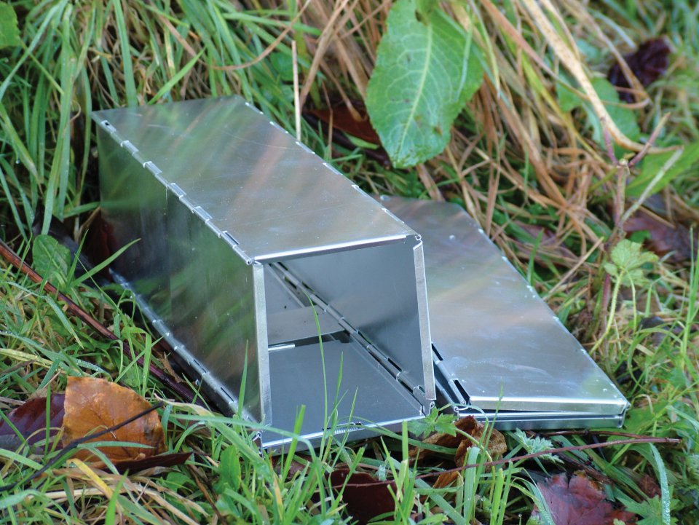
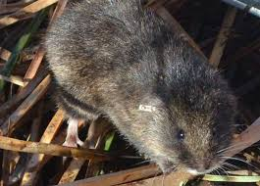
Mark-recapture problem
In a study In a study of meadow voles, set 300 live traps
you trap and mark and release 66 individuals
One week later, you set 300 traps again. You capture 52 individuals, 38 of which were marked
How many individuals are in the population?

Slide 10
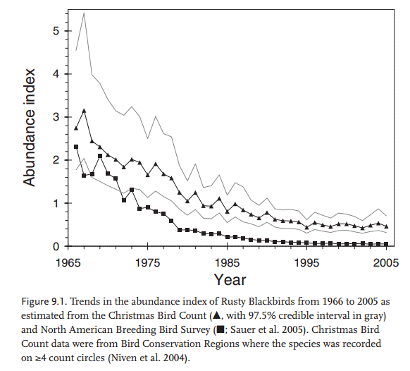
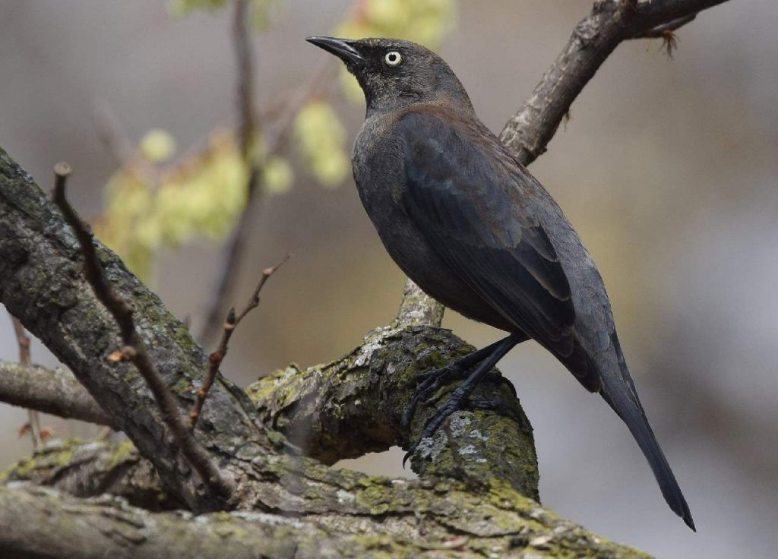
Density is not a static property of populations
Density changes whenever there are births of new individuals or deaths of existing individuals
Density changes whenever new individuals join the population (immigration)
Density changes whenever new individuals leave the population (emigration)
All population changes are driven by these four factors

Slide 11
Population Growth

Slide 12
Learning Goals
Describe three classes of spatial patterning exhibited by populations
Explain what information can be obtained from life tables

Slide 13
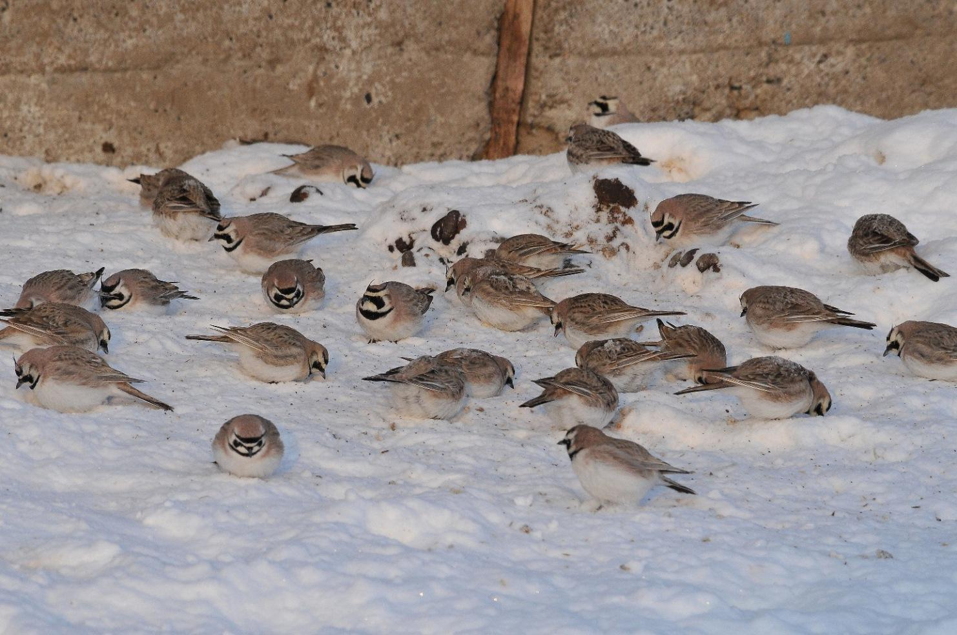
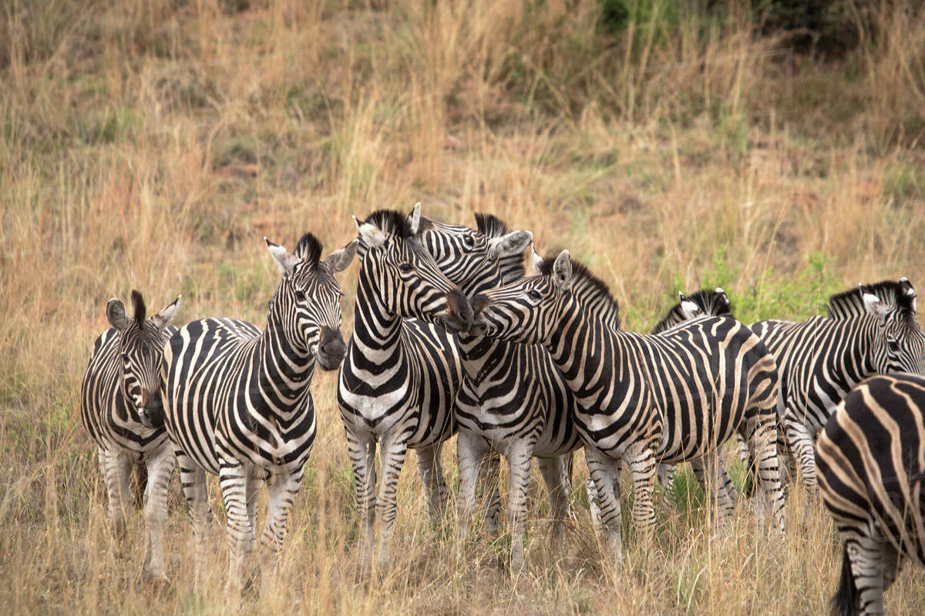
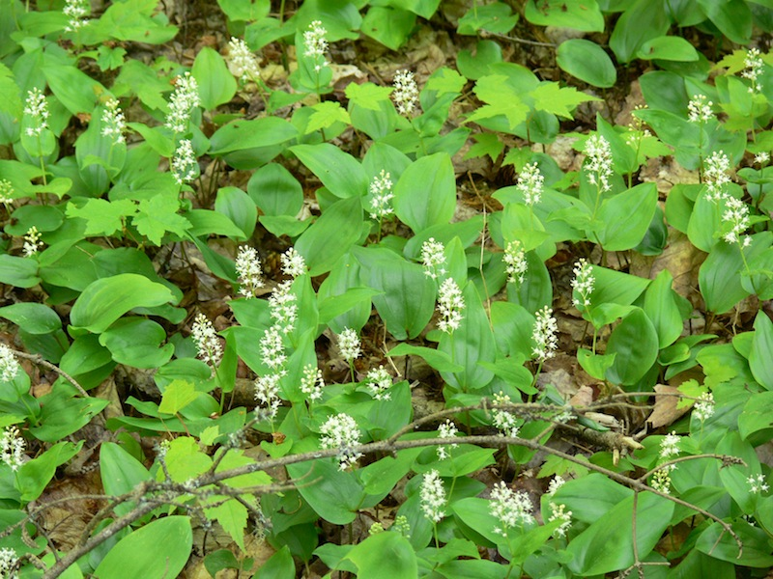
Patterns of dispersion
Clumped distribution
Individuals are aggregated in patches

Slide 14
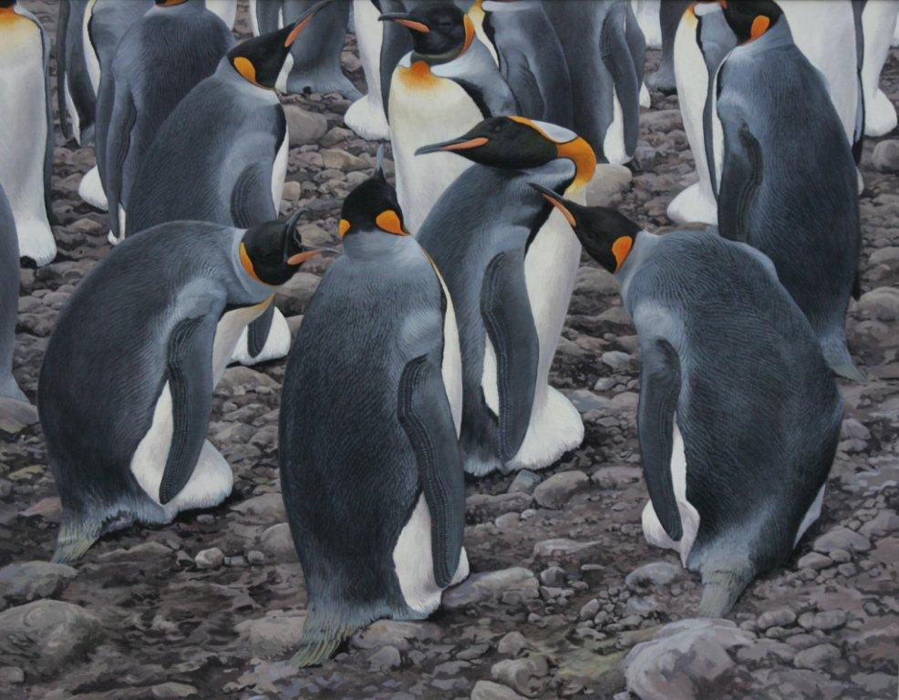
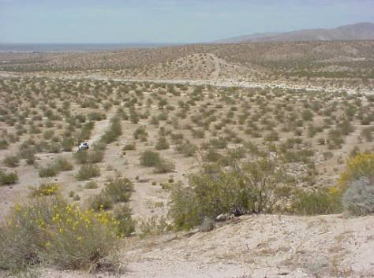
Patterns of dispersion
Uniform distribution
Individuals exhibit more or less even spacing—approximately the same distance between individuals

Slide 15
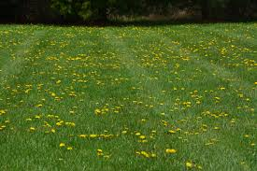
Patterns of dispersion
Random distribution
Neither uniform nor clumped

Slide 16
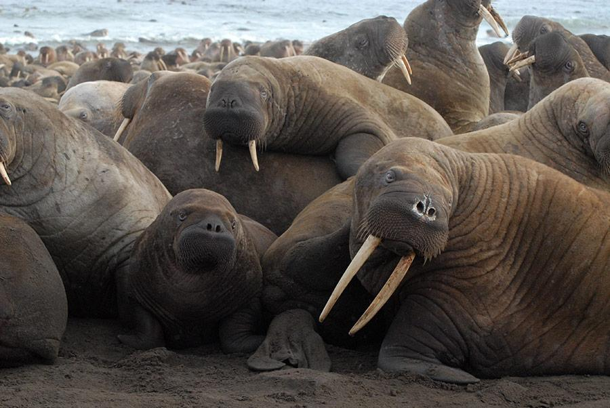
Demography - the study of survival and reproduction
Demography is the study of birth rates, death rates, immigration rates, and emigration rates and how they change over time

Slide 17
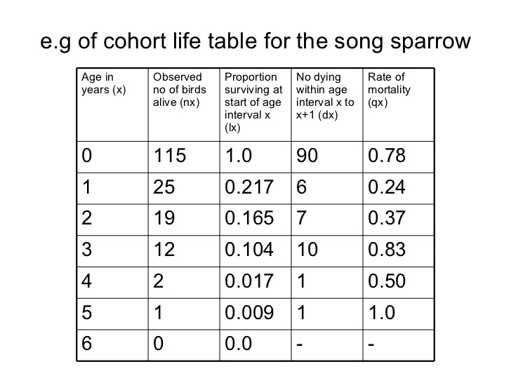
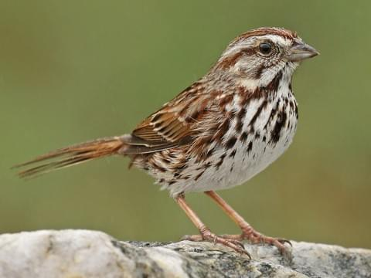
A life table summarizes age specific survival and reproduction
A Life table summarizes the survival and reproductive rates of individuals in specific age groups within the population
Constructed by following the fate of a cohort, a group of individuals the same age

Slide 18
Survivorship curves
Take a look at the third column of the life table. This is survivorship. It starts at 1.0 (everyone is alive) and goes to zero (everyone is dead).
Graph survivorship as a function of age (column 1)

Slide 19
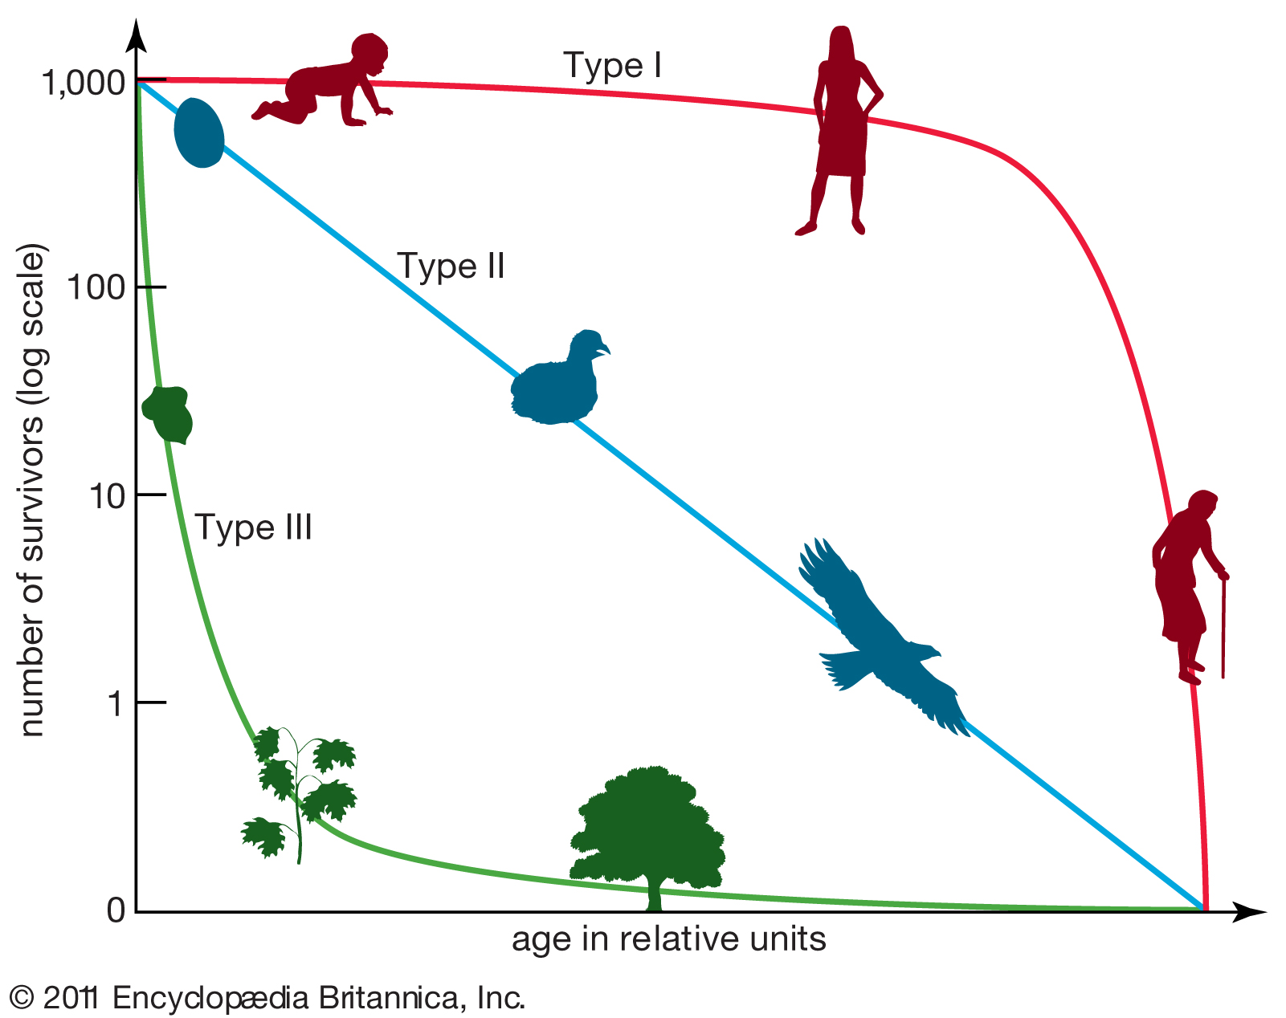
Survivorship curves
Your graph probably looks like the green line here. If your survivorship axis was log base 10 (as this one is) your graph would look more like the blue line.

Slide 20
Survivorship curves
Populations can be classified based on their survivorship patterns
Type 1
Type 2
Type 3

Slide 21
Population Growth

Slide 22
Learning Goals
Describe exponential growth in populations using mathematical expressions

Slide 23
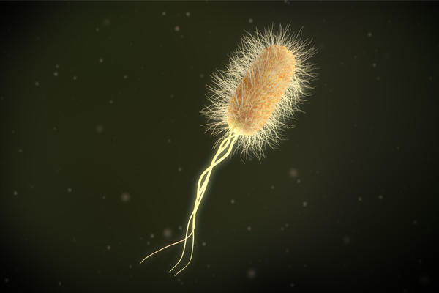
Exponential model of population growth
Populations of all species have the power to grow exponentially when resources are abundant
Linear vs. exponential growth example with a bacterium

Slide 24

Expressing change in population size
Populations increase with births, immigration
Populations decrease with deaths, emigration

Slide 25


Mathematically expressing change in population size

Slide 26

Mathematically expressing change in population size

Slide 27
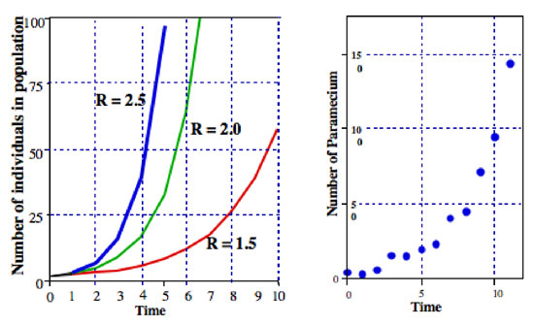

Slide 28
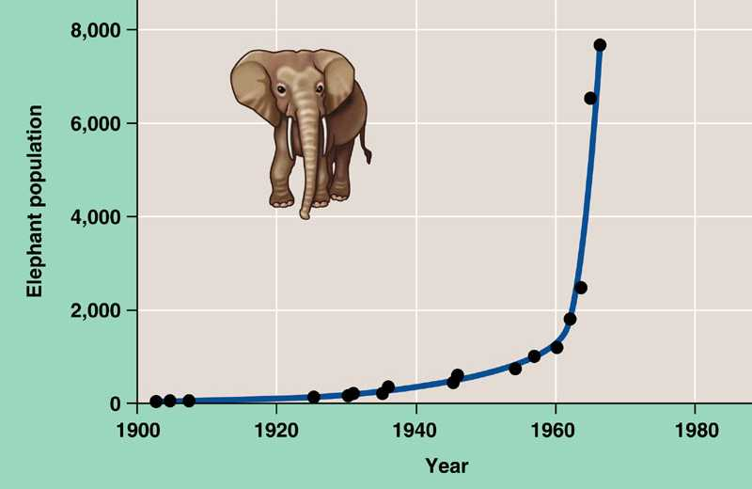
Elephants in Kruger National Park,
South Africa, following protection from hunting

Slide 29
Population Growth

Slide 30
Learning Goals
Describe the concept of carrying capacity and why it prevents unlimited exponential growth in populations

Slide 31
Carrying capacity
In the real world, resources are not unlimited
Carrying capacity (K) - the limit to the number of individuals that can occupy a habitat
Factors influencing K might include food availability, refuges sites from predators, water availability, suitable nesting sites…

Slide 32

Populations with a carrying capacity exhibit logistic growth

Slide 33
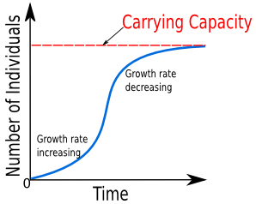

Slide 34
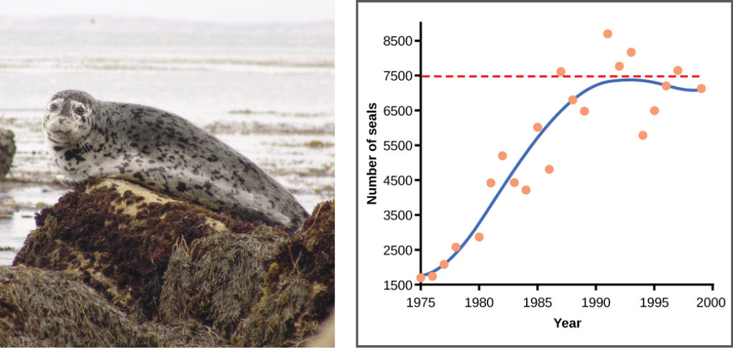
Logistic Growth in Fur Seals

